Slide 1

SiL, HiL testing plan for Year 2

Slide 2
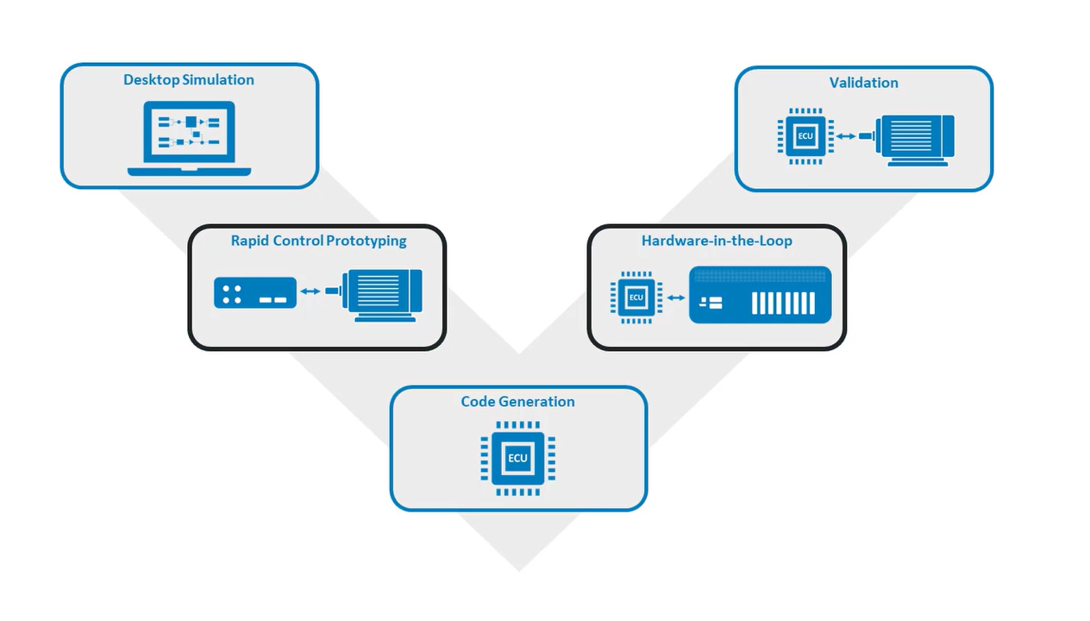
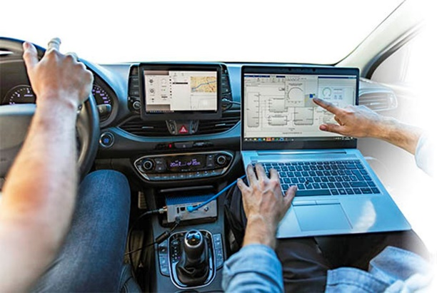
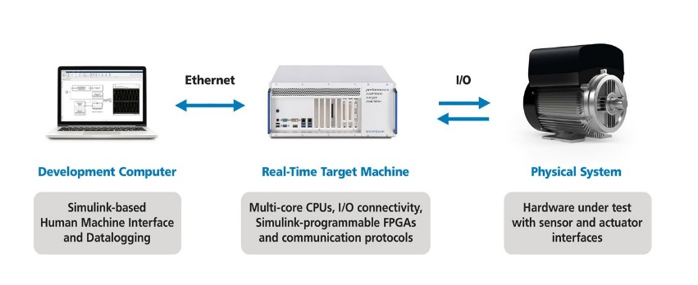
Verification and Validation process
Functional Requirements
MiL & SiL
HiL
Processor in Loop (PiL)

Slide 3
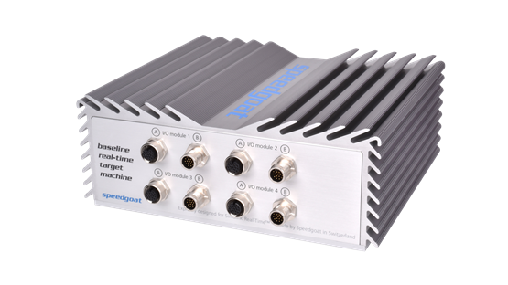
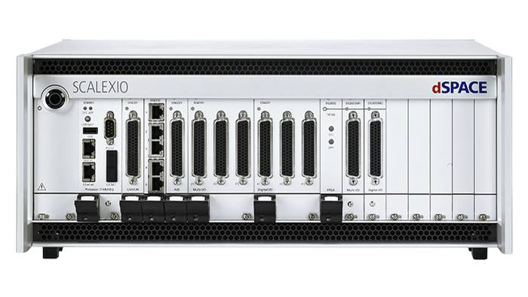
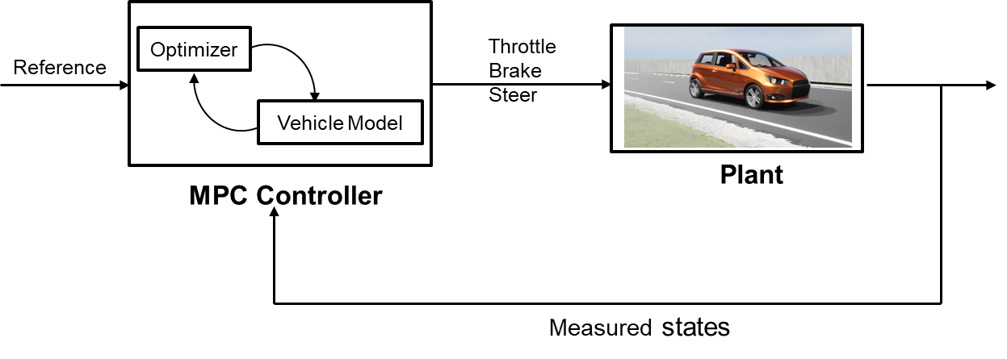

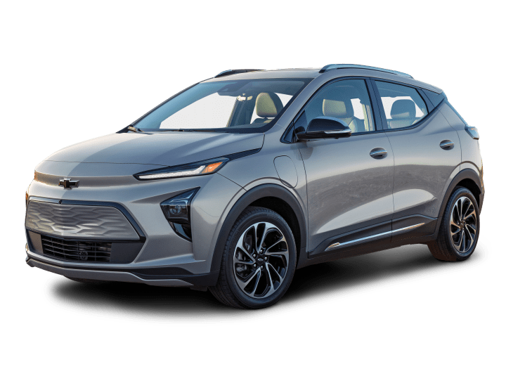

Hardware in the loop setup 1
CAN Interface
dSPACE Vehicle Dynamics Models
Digital Twin
Raw Control actions
Planning and Control
Vehicle Dynamics Model

Slide 4
Using the information on the tire-road friction coefficient, vehicle and traffic data and vehicle configuration, it is determined whether a safe lane change is possible.
Xiangkun He, Yulong Liu, Chen Lv, Xuewu Ji & Yahui Liu (2019) Emergency steering control of autonomous vehicle for collision avoidance and stabilisation, Vehicle System Dynamics, 57:8, 1163-1187, DOI: 10.1080/00423114.2018.1537494
-Use dynamic threat assessment model to evaluate risk associated with collision with surrounding actors based on road friction and the chosen vehicle configuration.
When a lane change is desired either to the right or left lane and possible in a safe way, the end point and maneuver time of the desired lane change maneuver are calculated
Ego States
Actor States
Modified Decision Making for lane change
Road Condition(friction)
Control Actions
Vehicle model & constraints

Slide 5
Faults: We choose a few ASIL-D faults (like Tire pressure loss/impact of friction (snow conditions) and analyze which fault is crucial.
Ackermann steering fault.
Brake Sluggish response
Unintended acceleration/ loss of acceleration(lateral)
Tire blowout
We describe the redundancy needed for a road vehicle to meet certain safety goals.

Slide 6
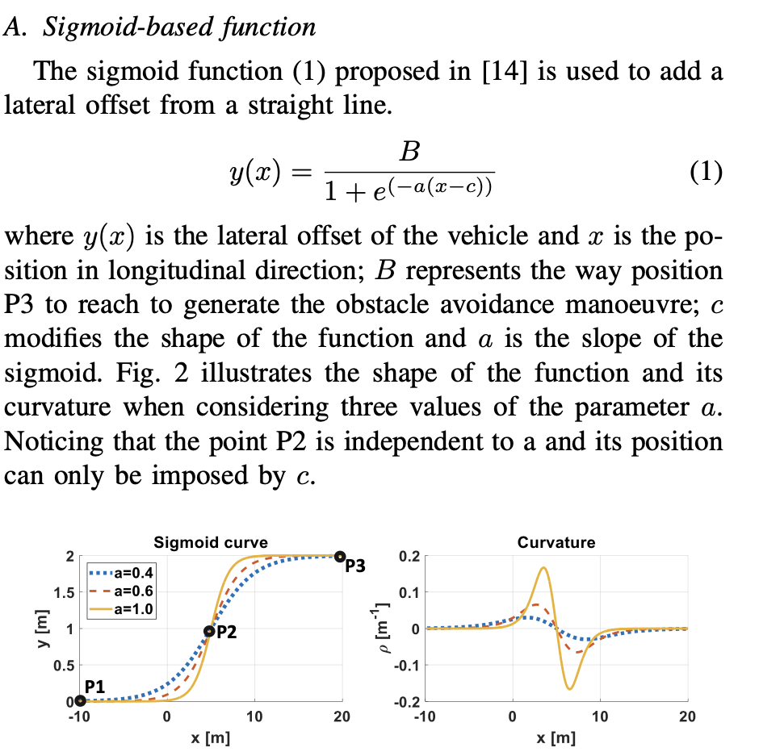
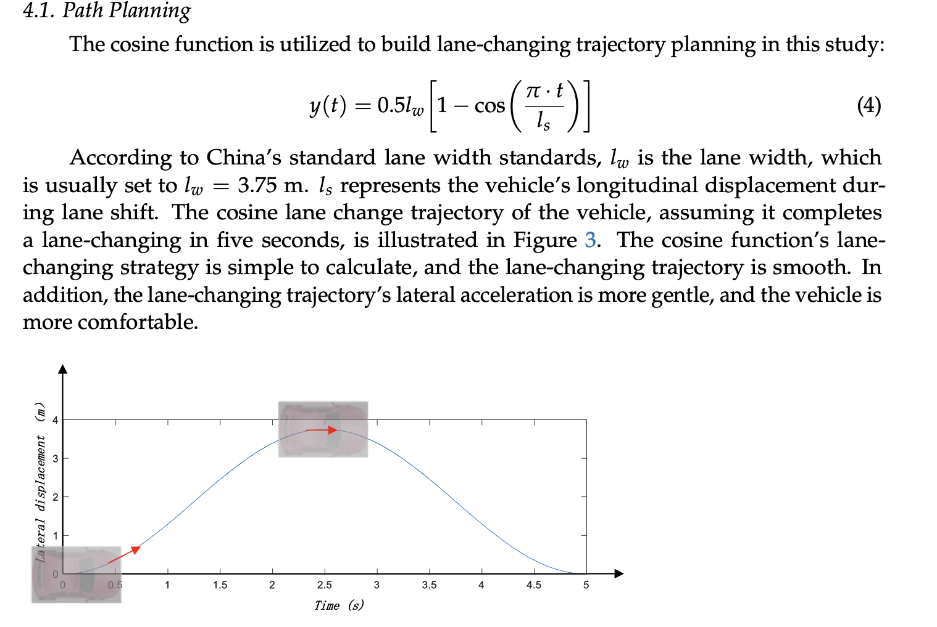
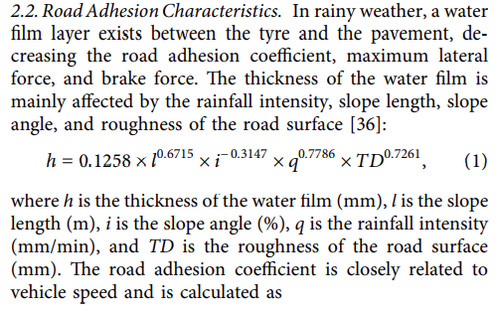
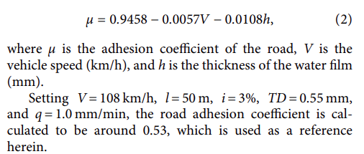
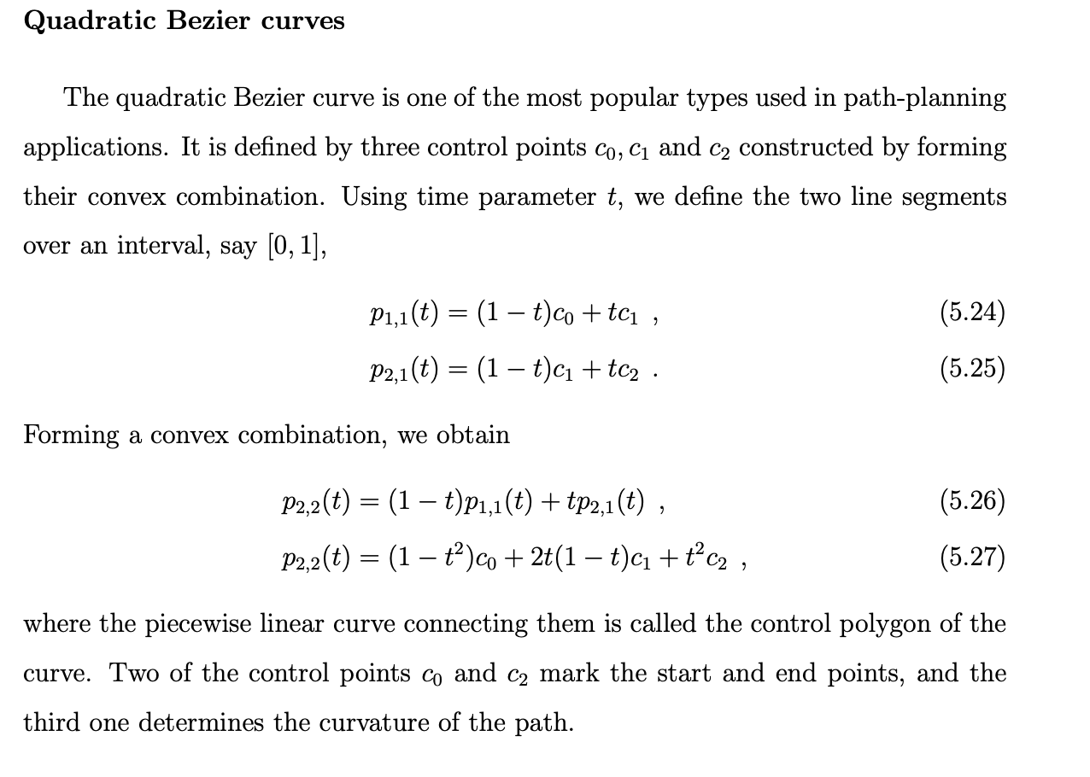
Ideas
Road adhesion coefficient as a function of vehicle velocity and thickness of water film
Safe longitudinal lane change distance based on conditions - optimization

Slide 7
Models to start with:
Two-track dynamics with dug-off tire model
Powertrain: FWD single motor open differential (Including the entire drive shaft dynamics) (for chevy bolt)
TTC-based decision logic and quintic polynomial trajectory for a lane change in presence of dynamic actors
The influence of these parameters on the resulting autonomous vehicle control system and vehicle motion is important.
How well the chosen vehicle configuration ( with these uncertainties) performs the lane change in the presence of dynamic actors? (lane change feasibility). Also analyze the comfort for occupants in terms of parameters – ax, ay, and yaw acceleration.
Perform sensitivity analysis.
Recommend possible changes in the decision logic, and vehicle configuration(torque split, lateral dynamics) which can satisfy the uncertainties for a safe lane change.

Slide 8
Parameters that are critical for lane changes during challenging weather conditions
Vehicle Speed
Vehicle speed adjustment based on the road conditions
Sensor performance
Accurate detection in the presence of adverse weather conditions
Traction control
Reliable traction system requirement
Monitoring wheel slip and adjusting motor’s power output.
Road information
Access to updated road information to adjust its behavior to ensure a safe journey.
Vehicle Dynamics
Vehicle mass distribution
Tire road friction
Torque control for wheels
Steering and braking
Adjusting the steering and braking commands/ pressure to maintain control.

Slide 9
Highway Challenge for AutoDrive 2 requirements.
Vehicle needs to avoid the static obstacle ( road barricades) and change the lane.
Current plan:
Working on lane change algorithm for dynamic actors/ static actors.
Various lane change trajectories

Slide 10
Three main categories in which path tracking algorithms can be classified: (1) Geometric path tracking methods; (2) Kinematic model-based path tracking methods; (3) Dynamic model-based path tracking methods
1) Geometric path tracking methods;
Based on the geometry of the vehicle and reference points.
2) Kinematic model-based path tracking methods;
By employing a kinematic model, all phenomena that occur between the wheels and the road, which give rise to the so-called slipping conditions, are neglected
3) Dynamic model-based path-tracking methods

Slide 11
Highway Lane Change development framework
Highway lane change for AutoDrive requires lane changing in the presence of a road barricade
(static obstacle and no moving vehicles)
Currently I am working on the model which can work for dynamic actors as well.
Lane change development process
Scenario and Sensor architecture design in MATLAB.
Sensor Fusion in Simulation
Reformat the sensor fusion data in a usable format.
Develop lane change algorithm

Slide 12
Developing lane change algorithm in the presence of dynamic actors.
Interaction with other cars. (positions , velocities)
Take into consideration the uncertainty and unpredictability.
Safety parameters need to be considered
Lane change decision
Develop the lane change Algorithm
Generate a trajectory that starts from the previous reference path and integrates into another lane
After changing the lane, another reference path has to be generated.
This process needs to be repeated whenever the vehicle performs the lane change and merges into another lane.
Reference points need to calculated in real time which is a challenge.
Trajectory planning

Slide 13
Current Work:
Trajectory generation and merging with previous path.
Keep on calculating the real time reference points for the vehicle to follow according to
Follow lane
lane change left
lane change right
The existing controller models cannot handle the lane change maneuvers.
These maneuvers are high speed and have high lateral components of velocities and accelerations.
Develop a trajectory tracking controller which can handle the lane changes.

Slide 14
Current software architecture
Scenario and sensor fusion models
Lane Change decision making model
Reference path generation in real time
Trajectory Generation
Dynamic model Stanley Controller
Single track 3 DOF bicycle model for vehicle Dynamics

Slide 15
Effect of environment and vehicle uncertainties on lane change maneuver
What if there are uncertainties in the environment ( like adverse weather changes) and vehicle system
Environment effects
Vehicle system uncertainties
Impact of Rain/ snow on the road characteristics.
Adhesion Coefficient as a function of vehicle velocity and film thickness
Vehicle mass distribution because of passengers.
Tire’s Cornering stiffnesses
Tire’s longitudinal stiffnesses
Will the existing model still be able to perform effective lane change? Or will the vehicle start slipping? or any other effects?

Slide 16

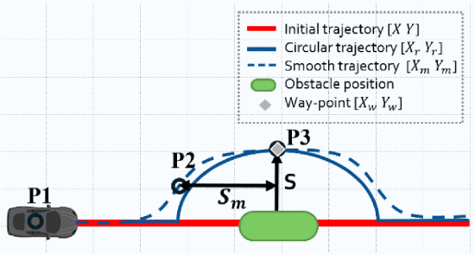
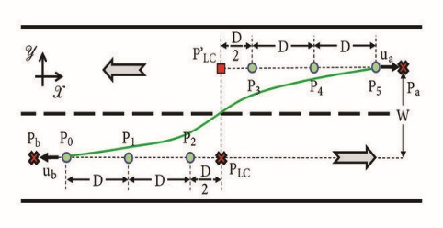
Parameter combinations for sensitivity analysis study on various trajectories
Vehicle and Environment uncertainties
Realistic Road adhesion Coefficient
Vehicle mass distribution
Tire parameters
Parameter Combinations for sensitivity analysis
Cubic polynomial
Sigmoid based
Bezier curve based ( cubic, quintic)
Cosine function
Tangent hyperbolic
Evaluate performance metrics for each of these trajectories
Determine the maximum lateral and longitudinal
accelerations and Jerks for each of these trajectories

Slide 17
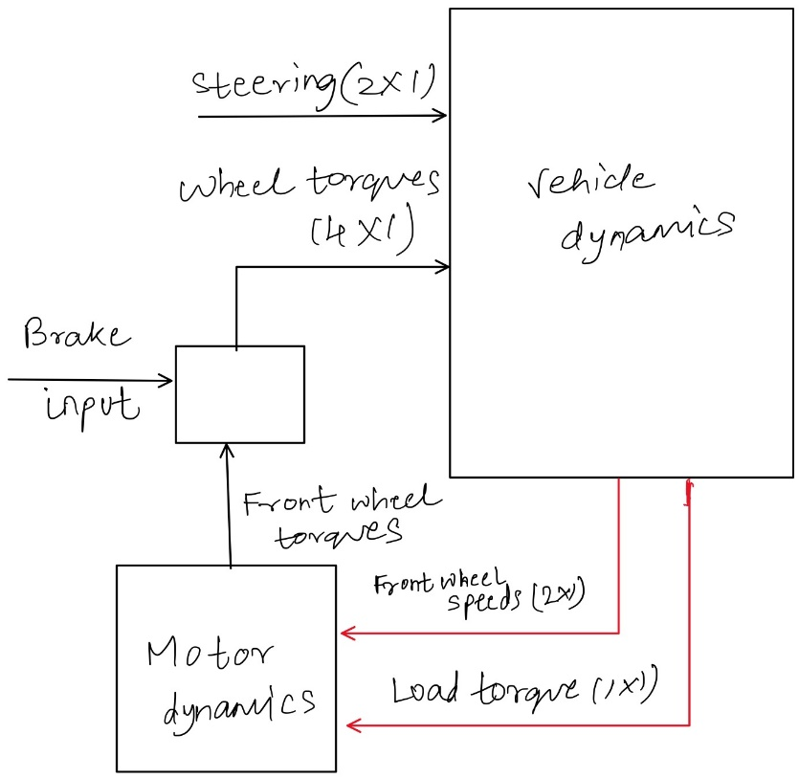
Vehicle Model and Dynamics
Ackermann steering
Two-track dynamics with dug-off tire model
Powertrain: FWD single motor open differential

Slide 18
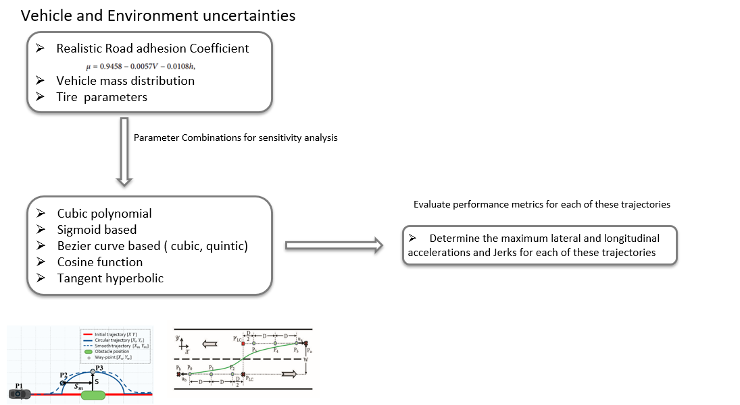
Develop an adaptive lane change system which consists of intelligent tracking
and control
Part 1
Introduce these environment and vehicle uncertainties in the current model and analyze the performance on the output.
Understand which uncertainties affect the performance metrics for the lane change the most.
Perform the sensitivity analysis using cross array design of experiments approach.
Part 2
Design a multilevel adaptive lane change model that can take the uncertainties into picture.
(Minimum safe lane change distance based on road adhesion )

Slide 19
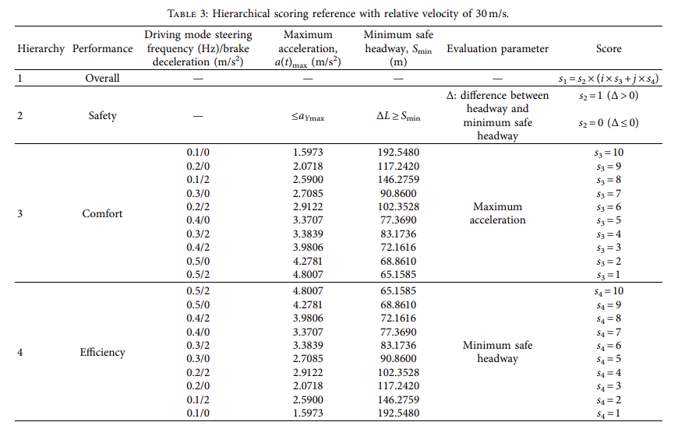
Lane-Change Model and Tracking Control for Autonomous Vehicles on Curved Highway Sections in Rainy Weather
Tao Peng,^{1,2}Li-li Su,³Zhi-wei Guan,⁴Hai-jing Hou,¹Jun-kai Li,⁵Xing-liang Liu,³and Yi-ke Tong⁶
Based on the scoring references under specific circumstances, a four-level lane-change mode for collision avoidance is proposed
Single track vehicle dynamics model
A scoring reference-based lane-change decision mechanism for collision avoidance on a curved road with low adhesion.

Slide 20
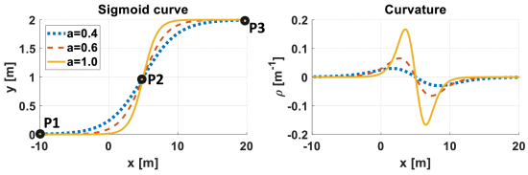
W. Ben-Messaoud, M. Basset, J. -P. Lauffenburger and R. Orjuela, "Smooth Obstacle Avoidance Path Planning for Autonomous Vehicles," 2018 IEEE International Conference on Vehicular Electronics and Safety (ICVES), Madrid, Spain, 2018, pp. 1-6, doi: 10.1109/ICVES.2018.8519525.
Use of a configurable sigmoid function to generate a path to avoid the obstacle and the use of a rolling horizon to plan for a decomposed area of the path.
Each horizon is calculated and updated at each step
Pros: Reactivity to the obstacle motion and the generation of a smooth trajectory in a low execution time

Slide 21
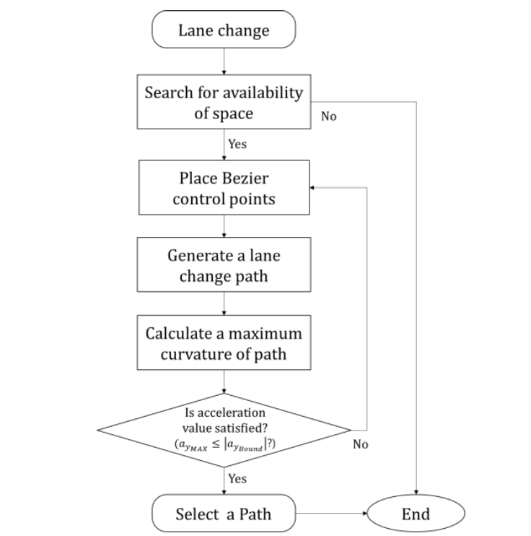
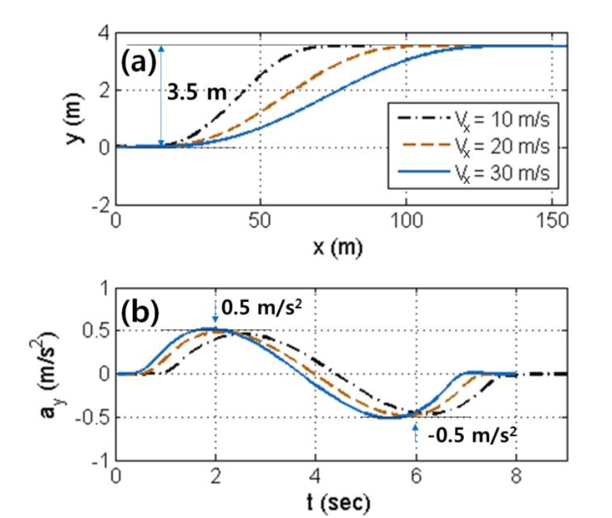

Lane Change Maneuver based on Bezier Curve providing Comfort Experience for Autonomous Vehicle Users
Il Bae1, Jin Hyo Kim2, Jaeyoung Moon1 and Shiho Kim1, Member, IEEE
Proposed an LCM algorithm based on evaluating the expected maximum lateral acceleration using the curvature of a Bezier curve and following the generated trajectory.
Used a desired lateral acceleration limit and compared it with bezer curvature limit
Used a linear bicycle model
No motor dynamics
No steer dynamics (Ackermann steering)
No variation in adhesion coefficients

Slide 22
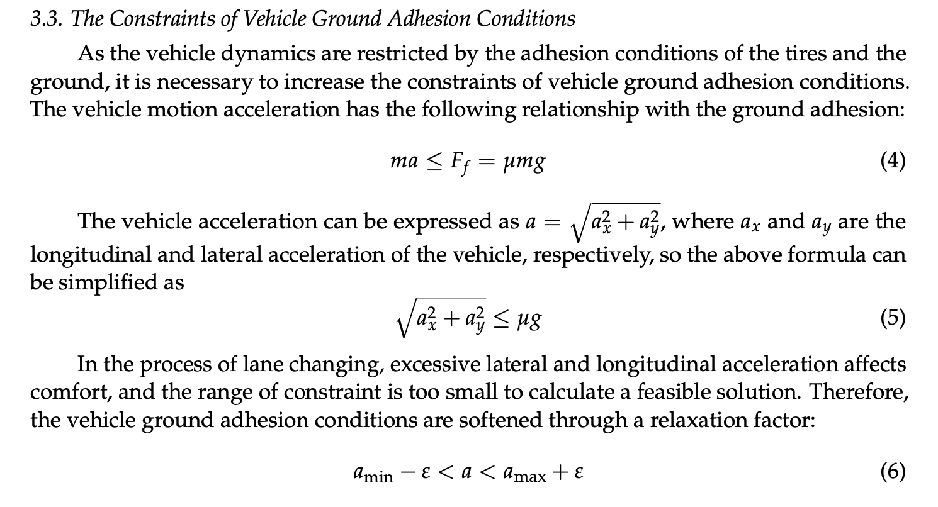
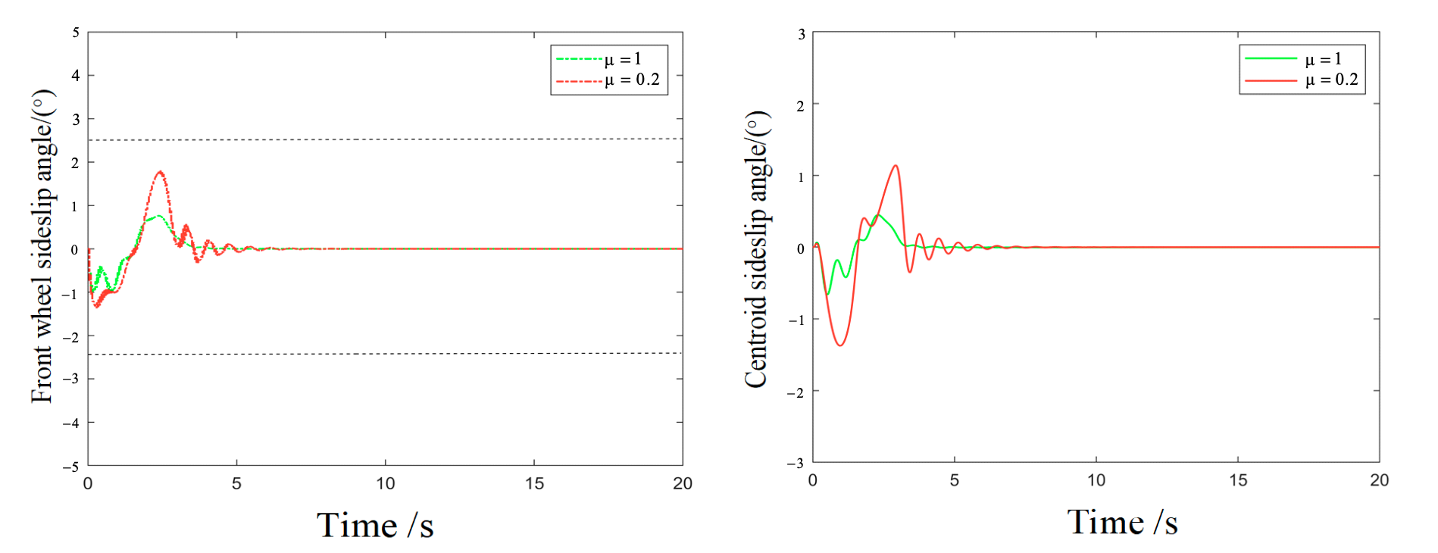
Lane-Changing Trajectory Tracking and Simulation of Autonomous Vehicles Based on Model Predictive Control
Hui Song , Dayi Qu *, Haibing Guo, Kekun Zhang and Tao Wang
MPC controller to track Quintic Bezier curve and validation for different road adhesions and vehicle speeds
Considered the ground adhesion (friction limits) for the
Acceleration constraints.
For different velocities, the MPC is able to handle the
Lane change with different friction coeff.
Focus on designing MPC controller with two track vehicle dynamics
With road friction friction constraints.

Slide 23
"Sensitivity Analysis of Vehicle Parameters for Heading Angle Control of an Unmanned Ground Vehicle."
Sahoo, S, Subramanian, SC, & Srivastava, S. - Proceedings of the ASME 2014 International Mechanical Engineering Congress and Exposition.
A realistic mathematical model of the vehicle considering the steering actuator dynamics has been developed by calculating the cornering stiffnesses from the basic tire information and the vertical load on each tire.
Sensitivity analysis has been carried out to check the robustness and stability of the controller by varying the cornering stiffness of tires, the most uncertain parameter.
Varied the longitudinal speed and analyzed the heading angle change
At lower speeds, the controller is more sensitive to the steering actuator dynamics and at higher speeds, the controller is more sensitive to the cornering stiffness of tires

Slide 24
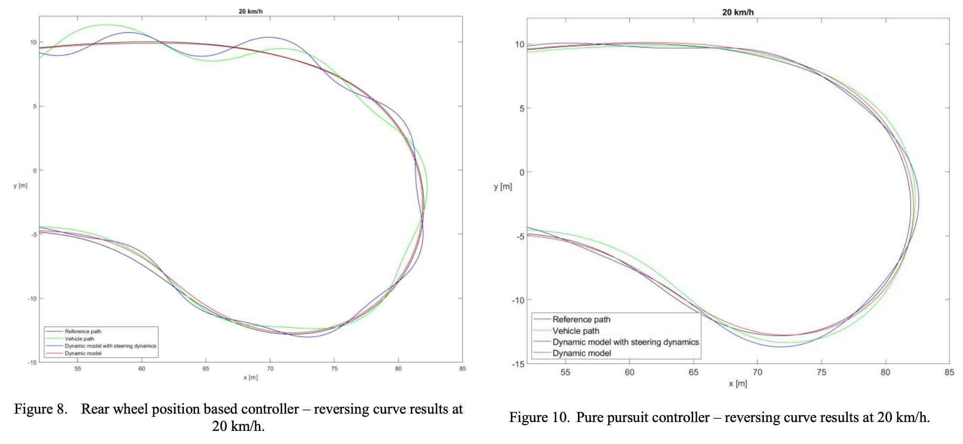
Modelling the dynamic behavior of the steering system for low speed autonomous path tracking
Ádám Domina, Viktor Tihanyi
Considered the dynamic behavior of the steering system, including the effect of the tires.
The path following simulation with the improved model was calculated, which was compared to the real vehicle measurement and the results showed good correlation.
Comparision with three different tracking controllers

Slide 25
Active Torque Vectoring in High Speed Lane Change Maneuvers." Steinbock, N, Prange, L, & Fabien, BC.
Proceedings of the ASME 2016 International Mechanical Engineering Congress and Exposition. Volume 4B: Dynamics,Vibration, and Control. Phoenix, Arizona, USA. November 11–17, 2016. V04BT05A034. ASME
We would like to increase the yaw and lateral accelerations that the vehicle can perform safely by controlling differing torques out of the two motors. Regulating these accelerations requires a control strategy over the left and right motor torques. Equal-torque control of the electric motors will be used as a baseline

Slide 26
Lane Changes with safety
Commonly used collision avoidance methods:
Artificial Potential Field
Reachability analysis
Dynamic Window Approach
APF obstacle avoidance methods mainly rely on the repulsive force generated when approaching an obstacle to drive the robot away from the obstacle.
Target destination represents attractive force and obstalces represent repulsive
Easy to incorporate other effects as attractive/repulsive forces
APF methods are simple and efficient
Obstacle avoidance method based on the reachable set and also suitable for avoiding moving obstacles in a dynamic environment.
Reachable set represents the target set that robots can reach safely via control under any disturbance
The runtime computation is complex
Takes into account the dynamics and motion constraints of the robot.
Obtain samples in the speed space of the robot, predict its possible motion trajectory, and then use an objective function to evaluate the possible trajectory and achieve obstacle avoidance.
DYNAMIC AVOIDANCE RISK REGION
The collision risk region of a moving obstacle in a dynamic environment is located along its moving direction. The size of this region is closely related to the speed of the obstacle. High speed indicates a large risk region.

Slide 27
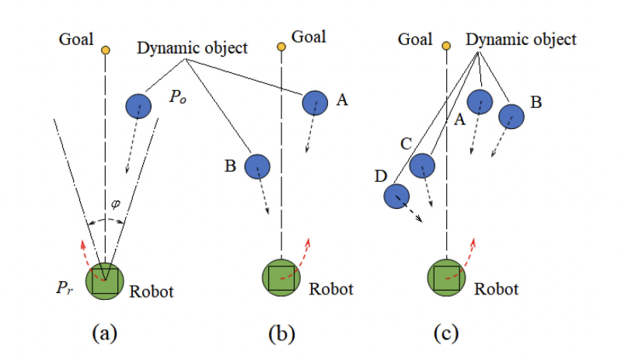
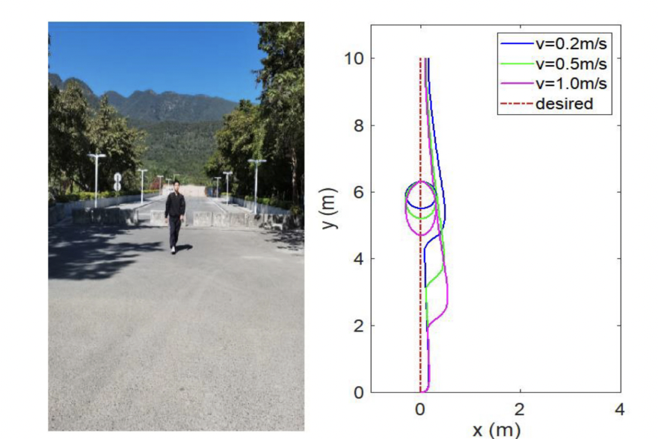
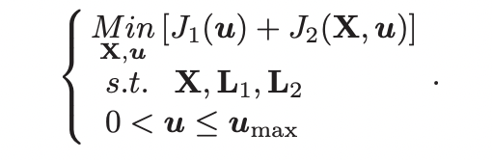
B. Guo, N. Guo and Z. Cen, "Obstacle Avoidance With Dynamic Avoidance Risk Region for Mobile Robots in Dynamic Environments," in IEEE Robotics and Automation Letters, vol. 7, no. 3, pp. 5850-5857, July 2022, doi: 10.1109/LRA.2022.3161710.
First, using the state estimation of the extended kalman filter, a dynamic obstacle avoidance risk region is constructed along the direction of the obstacle movement.
Second, the robot’s safe obstacle avoidance operation against dynamic obstacles combined with nonlinear model predictive control is realized
The state estimation of the moving object combined with the equation of motion is recursively updated using the EKF algorithm
The collision avoidance mainly considers the states of the obstacles (future positions, direction, velocities)

Slide 28
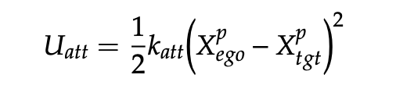
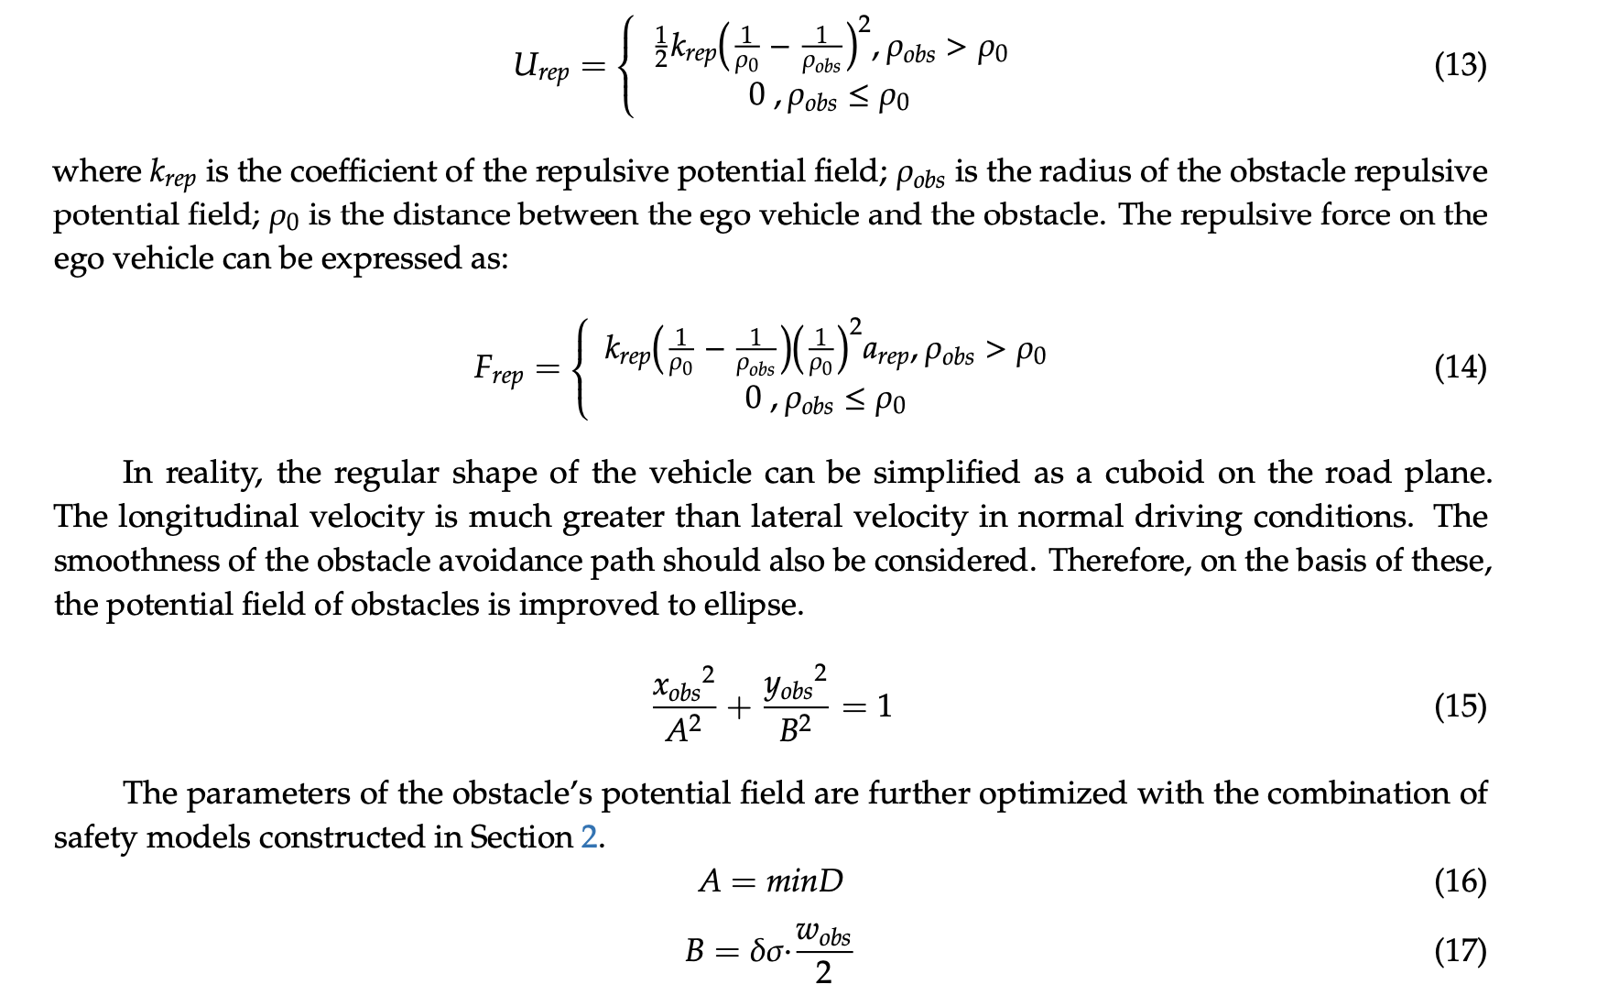
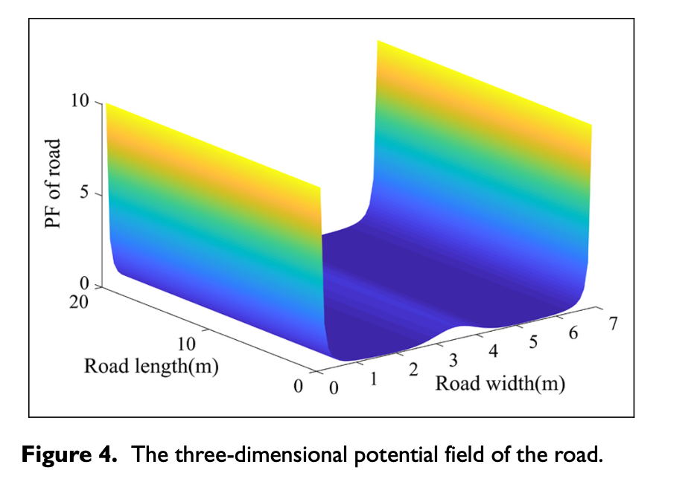
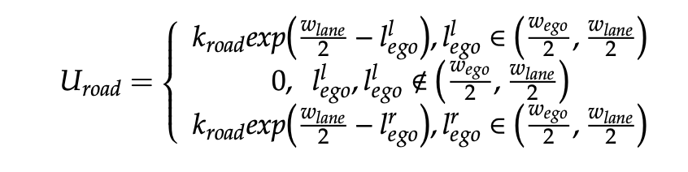
Artificial Potential Field Method

Slide 29
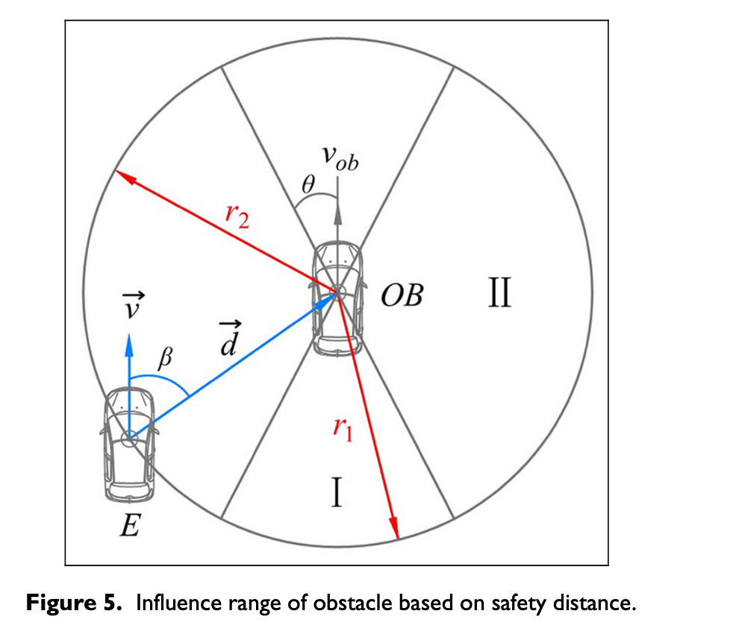
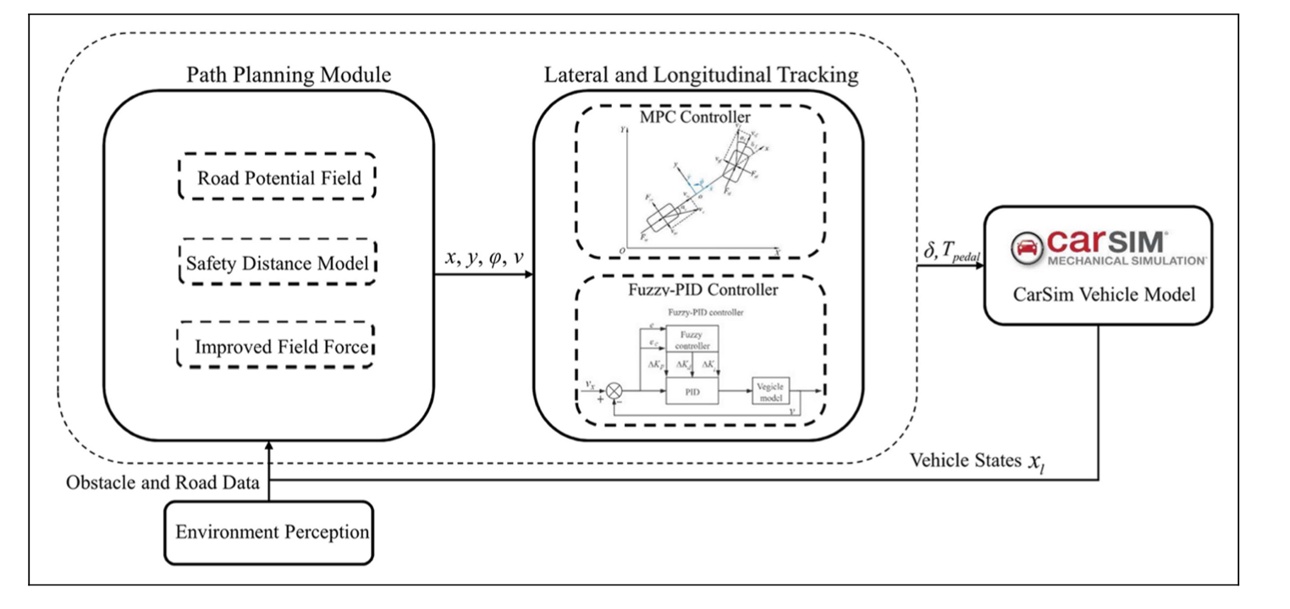
Feng S, Qian Y, Wang Y. Collision avoidance method of autonomous vehicle based on improved artificial potential field algorithm.
Proceedings of the Institution of Mechanical Engineers, Part D: Journal of Automobile Engineering. 2021;235(14):3416-3430. doi:10.1177/09544070211014319
Designed an improved APF method for generating a safe and stable collision-free path in a dynamic traffic environment.
First, Influence range of obstacles is determined by the position, speed and direction, which is no longer a fixed value compared with a conventional algorithm.
Second, based on different obstacles (the threat level is determined by the mass, size and speed), the proposed position repulsion works to prevent collision accidents, and the defined speed repulsion decelerates the autonomous vehicle when necessary

Slide 30
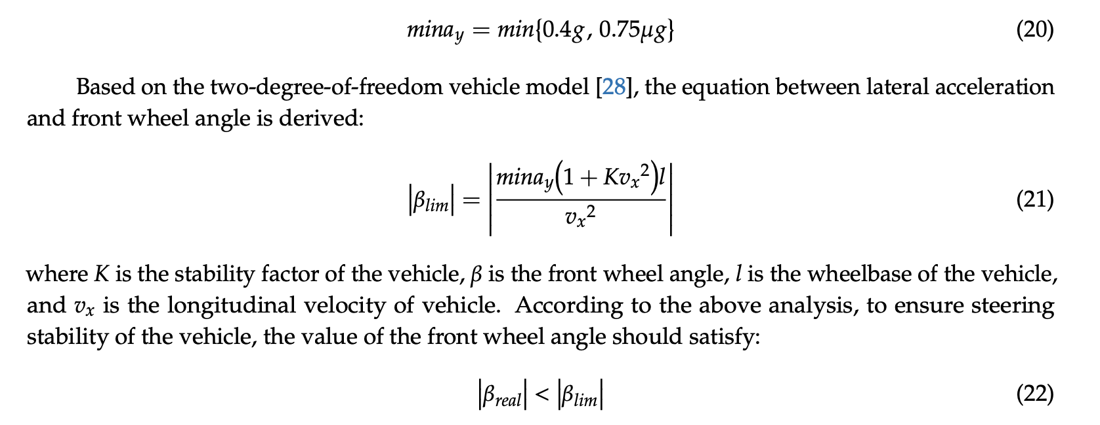
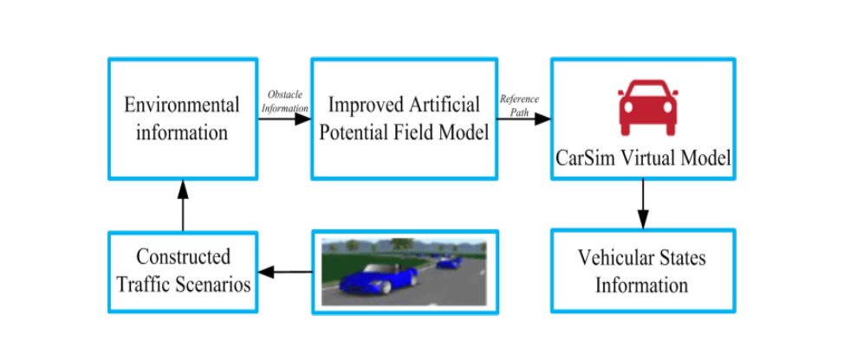
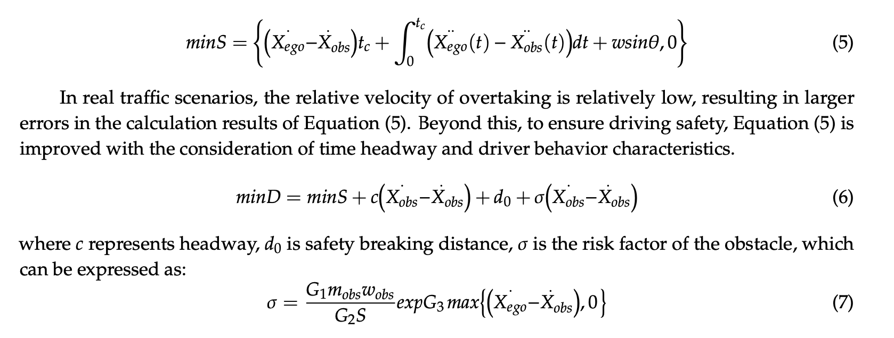
Wang P, Gao S, Li L, Sun B, Cheng S. Obstacle Avoidance Path Planning Design for Autonomous Driving Vehicles Based on an Improved Artificial Potential Field Algorithm. Energies. 2019; 12(12):2342.
Firstly, by analyzing the obstacle avoidance behavior of a human driver, a safety model of obstacle avoidance is constructed.
Then, based on the safety model, the artificial potential field method is improved, and the repulsive field range of obstacles are rebuilt
Safety Model of Obstacle Avoidance:
Obstacle avoidance model is constructed by combining the driving risk model and driver behavior characteristics

Slide 31
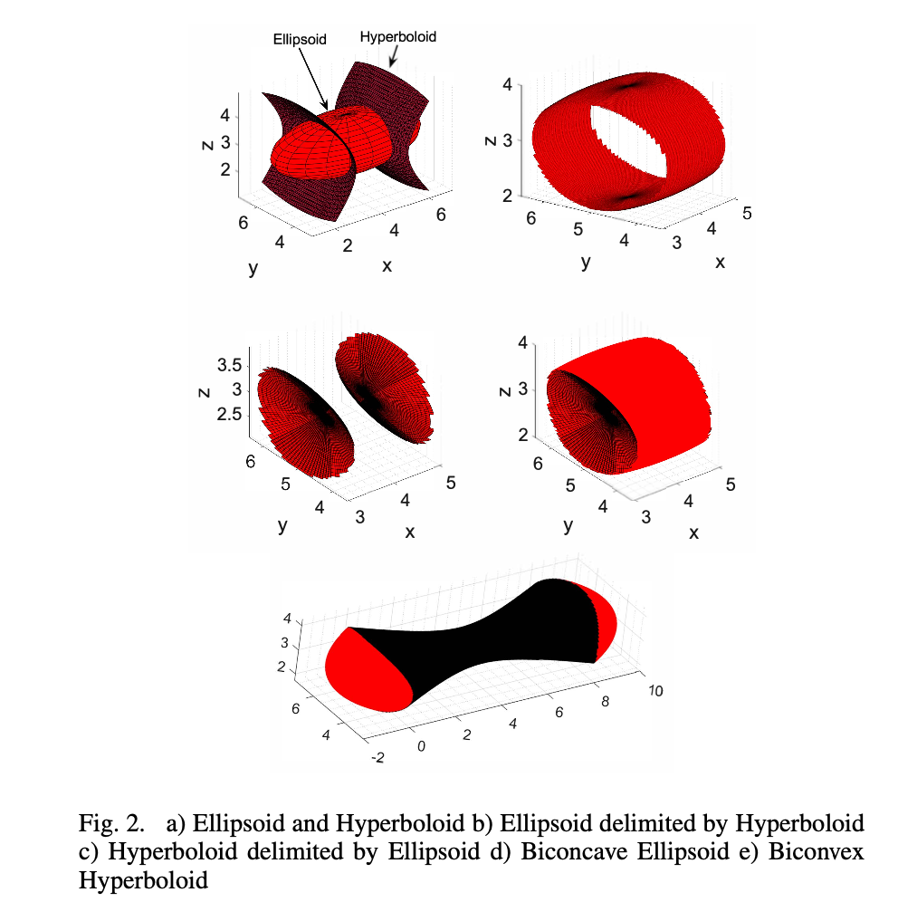
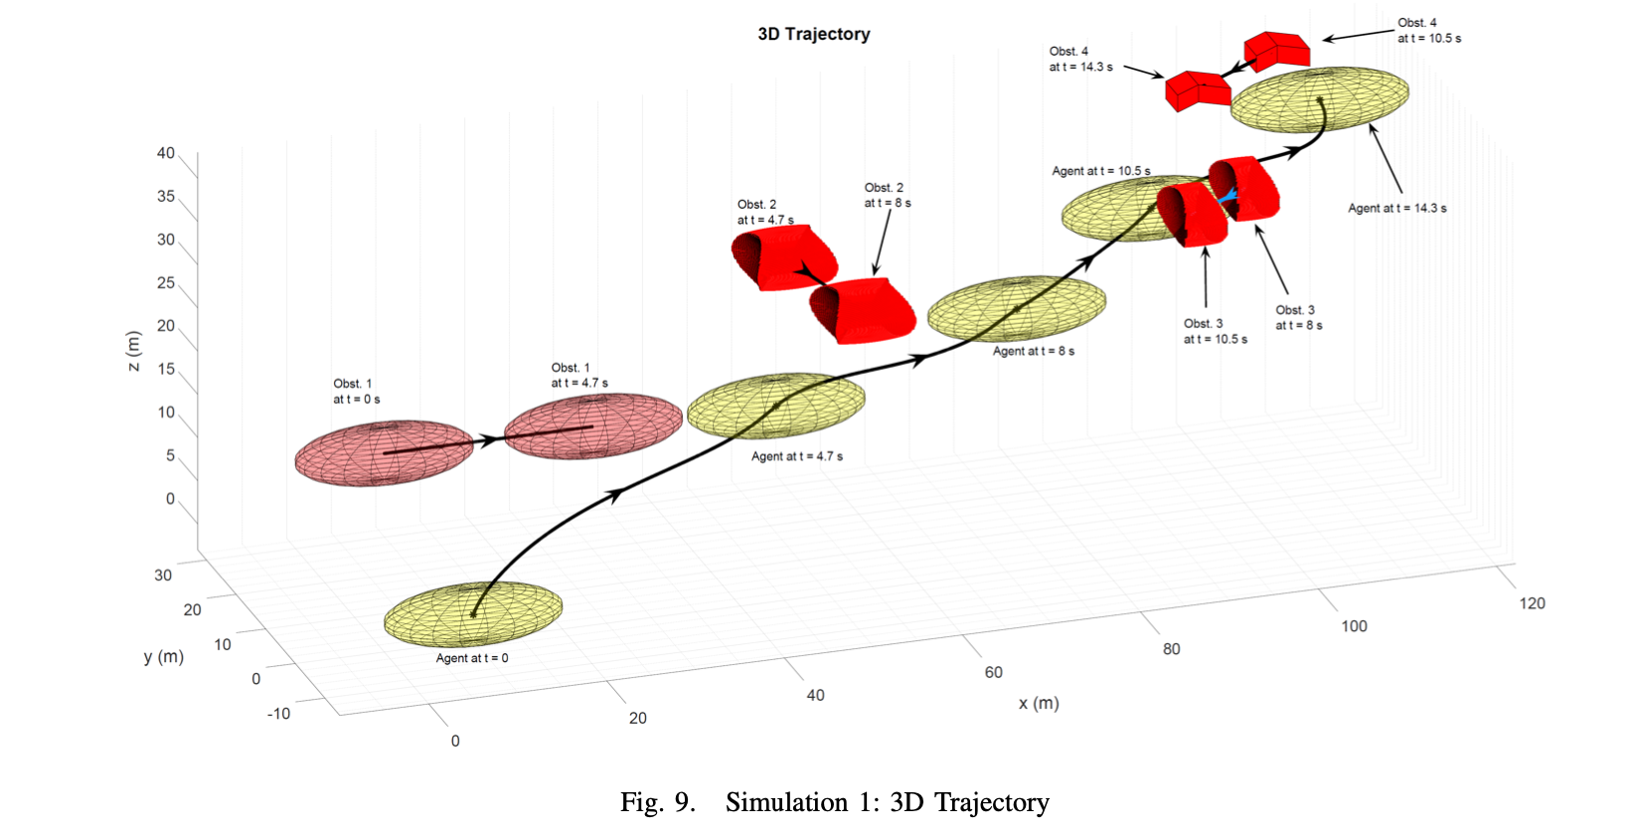
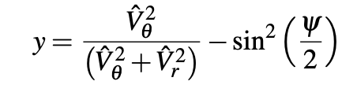
Collision avoidance of 3-dimensional objects in dynamic environments
K Dhal, A Kashyap, A Chakravarthy - arXiv preprint arXiv:2203.09037, 2022 - arxiv.org
Modelled the shapes of the objects using suitable combinations of ellipsoids and one-sheeted/two-sheeted hyperboloids, and employ a collision cone approach to achieve collision avoidance.
If the velocity vector of A lies inside the collision cone, then A is on a collision course with B, and needs to apply a suitable lateral acceleration aA to drive steer its velocity vector out of the collision cone.
This paper employs a collision cone based approach to de- termine collision avoidance laws for moving objects having elongated, non-convex shapes
The collision region is based on just the relative
Velocities of objects.

Slide 32
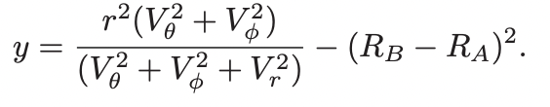
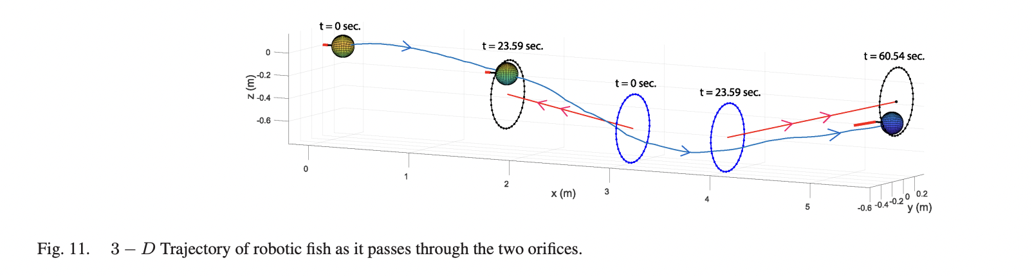
Model-Based Control of a Robotic Fish to Enable 3D Maneuvering Through a Moving Orifice
IEEE ROBOTICS AND AUTOMATION LETTERS, VOL. 5, NO. 3, JULY 2020
Given two moving objects A and B, A will pass through the orifice B, if the relative velocities belong to a specific set This set of relative velocities can be encapsulated
If the relative velocity vector does not lie inside this cone, then A needs to apply an appropriate acceleration a, that will steer the relative velocity vector into this cone, and this in turn will facilitate passage of A through B.

Slide 33
An Improved Artificial Potential Field Model Considering Vehicle Velocity for Autonomous Driving
IFAC-PapersOnLine, Volume 51, Issue 31, 2018, Pages 863-867

Slide 34
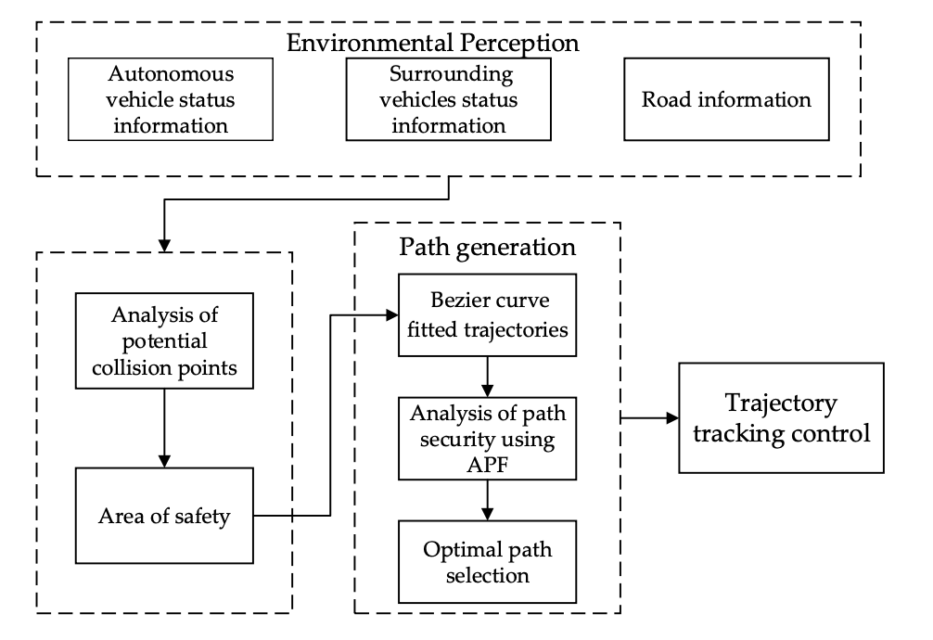
Yang, W.; Li, C.; Zhou, Y. A Path Planning Method for Autonomous Vehicles Based on Risk Assessment. World Electr. Veh. J. 2022, 13,234. https://doi.org/10.3390/ wevj13120234

Slide 35
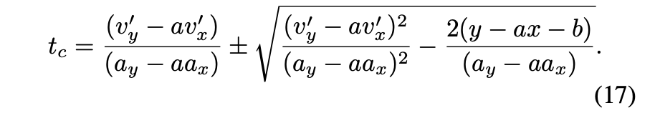
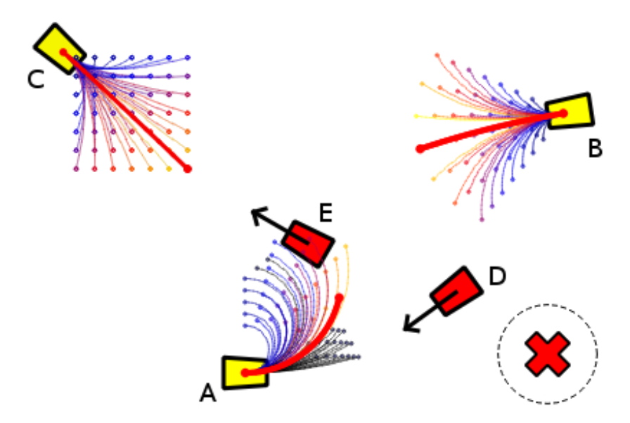
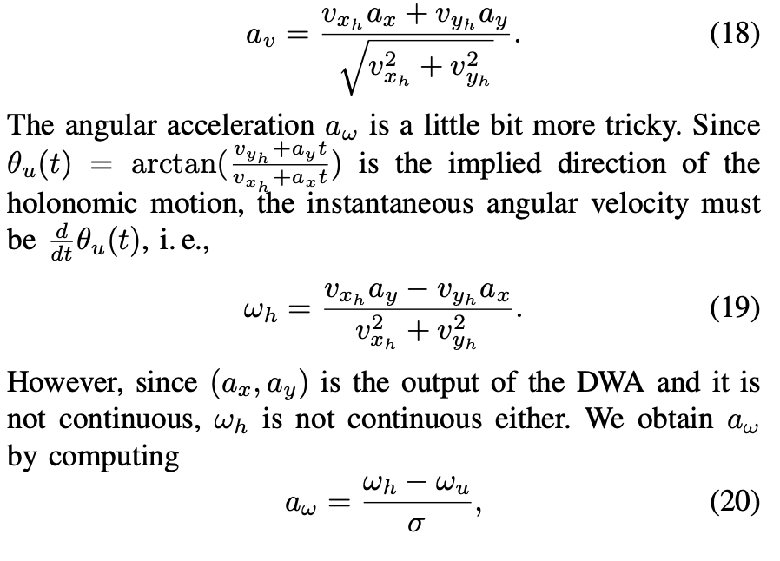
Predictive Collision Avoidance for the Dynamic Window Approach
2019 International Conference on Robotics and Automation (ICRA), Montreal, Canada, May 20-24, 2019
Change in the Dynamic Window Approach—a dynamic collision model—that is capable of predicting future collisions with the environment by also taking into account the motion of other objects
introduced a new version of predictive a DWA controller that explicitly models moving objects as polygons with velocities and computes future collisions.

Slide 36
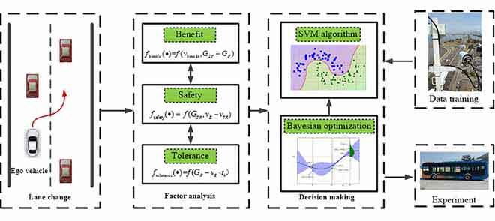
Y. Liu, X. Wang, L. Li, S. Cheng and Z. Chen, "A Novel Lane Change Decision-Making Model of Autonomous Vehicle Based on Support Vector Machine," in IEEE Access, vol. 7, pp. 26543-26550, 2019
Establishes an autonomous lane change decision-making model based on benefit, safety, and tolerance by analyzing the factors of the autonomous vehicle lane change.
Because of the multi-parameter and non-linearity of the autonomous lane change decision-making process, a support vector machine (SVM) algorithm with the Bayesian parameters optimization is adopted to solve this problem

Slide 37
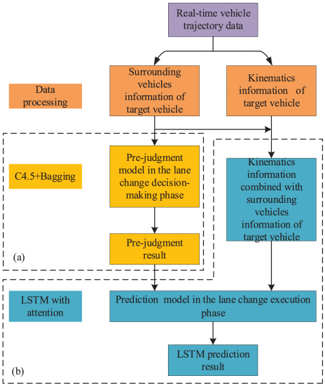
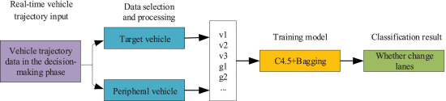
Z. -N. Li, X. -H. Huang, T. Mu and J. Wang, "Attention-Based Lane Change and Crash Risk Prediction Model in Highways," in IEEE Transactions on Intelligent Transportation Systems, vol. 23, no. 12, pp. 22909-22922, Dec. 2022, doi: 10.1109/TITS.2022.3193682.
An attention-based LSTM model is proposed in this paper for lane change behavior prediction in highways, considering both the surrounding vehicles’ information around the target vehicle at the current time and the historical trajectory data of the vehicle,
Pre-judgment model based on the C4.5 decision tree and bagging ensemble learning, and a multi-step lane change prediction model of LSTM with attention mechanism

Slide 38
Parameter combinations for sensitivity analysis study on various trajectories
Realistic Road adhesion Coefficient
Vehicle mass distribution and acceleration limits
Parameter Combinations for sensitivity analysis
Cubic polynomial
Sigmoid based
Bezier curve based
Cosine function
Tangent hyperbolic
Assuming this trajectory, create an attractive potential field that makes the vehicle follow this trajectory profile.
Decide on one final Trajectory

Slide 39
Part 1. Developing a rule based with TTC safety metric for lane change (AutoDrive 2 MathWorks simulation)
Environment and simulated sensor data
Highway Lane change decision making based on TTC
Trajectory Tracking and Control
Part 2. Performance analysis on the existing lane change decision making and tracking
Add uncertain Road conditions (Friction Coefficient)
Add Vehicle mass uncertainty
Test different trajectories ( Bezier, sigmoid, cosine, polynomial)
Part 4. dSPACE real time validation
Part 3. Develop artificial potential field lane change decision making and control
U_target
U_road_edge
U_lane
U_actor (Adding uncertainty effect)
U_road_friction (Adding uncertainty effect)
U_trajectory (Adding trajectory constraint into APF)

Slide 40
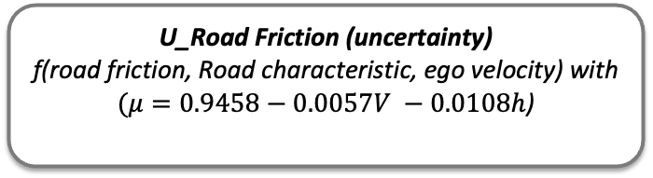
Defining all the possible potentials for lane changing application
U_target
Attractive potential which leads the host vehicle to the desired target location
Repulsive potential from the actor
(Ego vehicle mass uncertainty)
To keep the host vehicle a safe distance from other obstacle vehicles.
U_actor = f(relative distance, mass of actor and ego, absolute velocity of the ego, relative velocity of the actor)
U_road_lane
Lane potential generates a barrier for lane changing and guides the host vehicle driving along the centre line of itslane
U_road_edge
Road edge potential prevents the host vehicle from lane
departure by employing the repulsive potential function on
the left and right of the road.
U_Road Friction (uncertainty)
f(road friction, Road characteristic, ego velocity) with
$(μ=0.9458−0.0057V −0.0108h$)
U_trajectoryProfile
This potential will be responsible to choose the next point that would follow the chosen trajectory
(Adding the profile as a constraint to optimization)

Slide 41
Repulsion potential field between actor and ego
Influence range using ego vehicle mass,
Ego velocity
Influence range using minimum braking distance,
size of the actor(width).
Finally the repulsion field is a function of f(relative distance, relative velocity of the actor, heading direction)

Slide 42
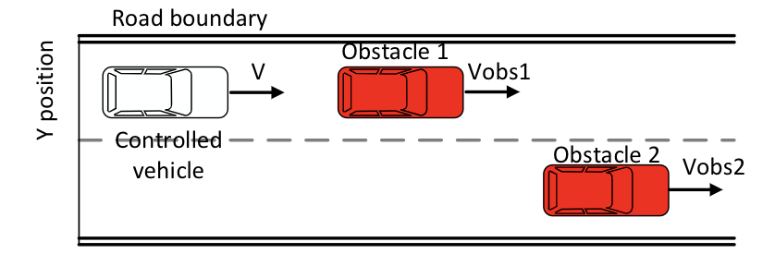

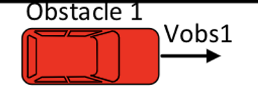

(Repulsive)

Slide 43





Equations for APF (Implementation)

Slide 44
Tasks
Asphalt to concrete road transition (snowy road transition on bridges)
Connection between different parts in my thesis
Show the existing decision logic (doesn’t have road friction, vehicle and actor mass parameters)
Check if you can use these forces into existing rule based methods.
APF applications and literature review

Slide 45

Rule based Lane change planner
Inputs :
Ego and actor states (from sensor detections)
Lane Boundary information
Road speed
Outputs:
Lane Change decision
Left Lane change
Right lane change
Stay in the lane with ACC

Slide 46
Section 1:
At every time step:
Extracts the Ego state information,
Localizes the ego vehicle on the road (lane number )
Initialize parameters
Section 2:
For each confirmed track ( Actor information from the sensor):
Extract the actor position, velocity
Checks if the actor is within certain critical region with respect to ego. (Most important objects)

Slide 47

Section 3: For each confirmed track,
Check if the actor is in the same lane as of ego and also the position (front or back)
If the actor on front:
Check the actor relative velocity and the if the ego velocity < desired or (road speed).
If yes, the ego intends to do a lane change according to the lane availability
If the actor on the back:
Ignore
For all other confirmed tracks and not in the same lane as ego:
Calculate Time to Collision ( TTC)
TTC = relative position/ abs(relative velocity)
TTC > 0 (Vehicle on the front (on left or right lane) TTC < 0 (Vehicle on the back-left or right lane)
Time to Collision. (TTC) means the time before a collision happens between involved vehicles/objects/subjects if their speeds would not change and taking into account their paths.
TTC_1
TTC_2

Slide 48
Using Road boundaries and lane information:
For each actor,
Categorize the actors which are on the left lane
Sub categorize the actors into front and back of ego on the left lane.
Calculate how fast the actor is moving with respect to ego
and calculate TTC for the actor.
If it is safe for the ego vehicle (TTC > threshold / actor velocity speeding up / ego velocity less than the desired
Velocity) with respect to all the actors on the left
- The ego vehicle can do a left lane change.
Similarly, check the same conditions for all the actors for the right lane.
If the conditions are safe with respect to either left lane or right lane, pass the lane change command.
If the conditions are suitable for both left lane and right lane:
The destination point and the high speed lane is given a preference to a particular lane
TTC_1
TTC_2

Slide 49
Trajectory Tracking and Control
Lane Change Decision Making
With the current decision making module,
The trajectory tracking module is can be used to simulate trajectory tracking with different vehicle mass, different friction coefficient and trajectory curves.
Log data and Plot acceleration and jerk curves
Trajectory tracking and control

Slide 50
Target Potential
Static obstacle potential
Road potential

Slide 51

Lane Changing with Icy road conditions:
Increase your following distance an extra 10 seconds when driving on icy, slippery surfaces. On four-lane highways, stay in the lane that is the most cleared of snow. Avoid changing lanes due to the potential of losing control over snow build up between lanes.
Two parallel lanes have different friction coefficient.
In this case, one lane has a different potential than the other.

Slide 52
Tasks
State flow diagram to show different rules in the current decision. Making module.
Explain the trajectory generation in dynamic APF.
How APF can handle this slippery road situation better than the rule based (if rules for slippery conditions are also incorporated)

Slide 53

State Flow Diagram for Lane Change Logic
Sensor Information
(Ego and actor vehicle states)
Stay in the lane
0 or 1
Road Boundaries
Change Left Lane
0 or 1
Road Speed Information
Change Right Lane
0 or 1

Slide 54






APF equations
Goal Potential
Road Potential
Actor Potential

Slide 55
Gradient descent algorithm
Road potential
Target potential
No obstacle case
start = [10,5.5];
goal = [390,2];
The goal is not reached since the road potential is symmetric about center line
Need to find a better target potential (concave and inclined towards goal)

Slide 56
Stuck in Local minima
start = [10,4];
goal = [390,2];
Local Minima= [134.2, 6.16]
Number of iterations run = 500

Slide 57
High centerline potential
With Improved obstacle potential
start = [10,4];
goal = [390,2];

Slide 58
Improved centerline potential but obstacle potential need to be improved
Improved road centerline potential (slightly decreased to achieve the next minimum point towards the centerline

Slide 59
Improved obstacle potential but still lane change path is not smooth
Improved obstacle and centerline potential
Still the lane change path is not smooth

Slide 60
Lane change distance approximately 50 m. The obstacle potential can be further improved for a longer lane change
distance.
Smoother curve

Slide 61
Lane changes with two obstacles
Elliptical target potential
f3 = 1/200*( (X - x_tar).^2 + (1/50)*(Y- y_tar).^2 )
start = [10,5.5];
goal = [390,2];

Slide 62
Linear Target potential
f3= -4*(X-x_tar);

Slide 63
Implementation for moving obstacles
Construct static Artificial potential field
F1= U_goal + U_road
Construct obstacle potentials (based on current position, velocity)
Add F= F1+F2
Apply Gradient Descent to calculate the next reference point
Update vehicle next position and velocity
next = grad_desc(start,goal,F,max_iter,dist_tol)

Slide 64



Improve obstacle potential and road potential by incorporating speed and friction coefficient
U_Road Friction
f(road friction, Road characteristics)
1) Road friction – static value for one side of the lane
A relatively high road potential for a low friction road surface helps to decide whether to change lane or not.
2) Incorporating friction effect in obstacle potential
Add effect of friction inside obstacle potential which increases the obstacle potential along the vehicle movement direction.
High obstacle potential with decrease in friction coefficient. This improves the safety distance of ego from the obstacle.

Slide 65


Pure pursuit controller and 3DOF dual track for tracking
$$μ=0.9458−0.0057V −0.0108h$$

Slide 66
Vehicle Tracking for double lane change.
Original Path vs Vehicle tracking
Lateral Error during double lane change.
Yaw angle during double lane change

Slide 67




WHY APF?? Pros and Cons
$$U_{edge}$$
$$U_{Center}$$
$$U_{edge}$$

Slide 68




Road Potential
Target potential
Way points
(x,y,theta)
Improved Obstacle Potential

Slide 69





Slide 70


Overall Block Diagram
Gradient Descent
Potential Fields
Way Points

